Slide 1
1.2 Text, sound and images
Understand how and why a computer represents • text and the use of character sets, including
Text is converted to binary to be processed by a computer
American standard code for information interchange (ASCII) and Unicode
Unicode allows for a greater range of characters and symbols than ASCII, including different languages and emojis
Unicode requires more bits per character than ASCII
Understand how and why a computer represents • sound, including the effects of the sample rate and sample resolution
A sound wave is sampled for sound to be converted to binary, which is processed by a computer
The sample rate is the number of samples taken in a second
The sample resolution is the number of bits per sample
The accuracy of the recording and the file size increases as the sample rate and resolution increase
Understand how and why a computer represents an image, including the effects of the resolution and colour depth
An image is a series of pixels that are converted to binary, which is processed by a computer
The resolution is the number of pixels in the image
The colour depth is the number of bits used to represent each colour
The file size and quality of the image increases as the resolution and colour depth increase

Slide 2
Note:
Even though Cambridge says:
Text then sound then images
We will do text then images then sound.

Slide 3
Today
Understand how and why a computer represents • text and the use of character sets, including
Text is converted to binary to be processed by a computer
American standard code for information interchange (ASCII) and Unicode
Unicode allows for a greater range of characters and symbols than ASCII, including different languages and emojis
Unicode requires more bits per character than ASCII
Understand : What is ASCII
Able : Decode ASCII
Answer : What alternatives are there?

Slide 4
ASCII
ASCII is American Standard Code for Information Interchange
It is a code to represent English letters, numbers and characters.

Slide 5
How can you and a computer communicate?
You cannot speak binary...so what happens?

Slide 6
Standard ASCII code is made up of 7 bits.
2⁶
2⁶ bits mean you can have 128 characters (including 0)
Standard ASCII is split up into 2 sections:
Non Printable - System codes like ESC, ENTER - these are between 0 -31
Printable - from 32- 127

Slide 7
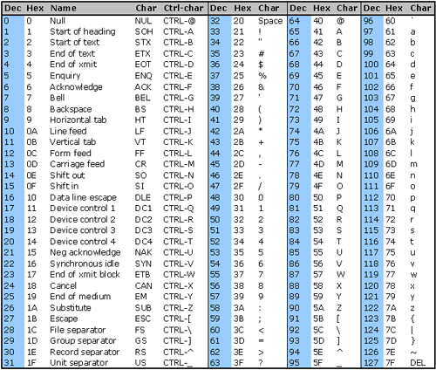
Non Printable

Slide 8
Printable
So if you the word Cat
Its 67, 97, 116
1000011 1100001 1110100

Slide 9
What are your initials in Binary?

Slide 10
I lied....(kind of...)
Standard ASCII code does have 128 characters (printing and system combined) - 2⁶
But there is also Extended ASCII.
Extended ASCII has 2⁷ - 256 characters (including 0)
Extended ASCII allows for extra characters, symbols and support for other languages!!

Slide 11
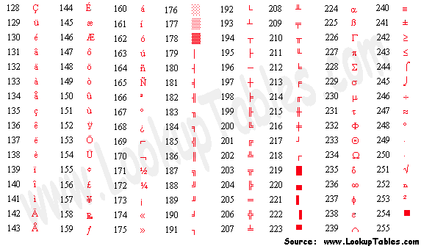
Extended ASCII

Slide 12
Quick Quiz
1. What language does a computer understand?
2. What does the abbreviation ASCII stand for?
3. How many bits does standard ASCII use?
4. How many characters does this mean standard ASCII has?
5. Standard ASCII is broken up into two sections - what are these?
6. The first ???? codes in ASCII are system codes
7. Convert 97 into binary
8. Convert 01100001 into denary
9. How many bits does extended ASCII use?
10. How many characters does extended ASCII have?
11. What benefit does Extended ASCII allow for?

Slide 13
Question
Do you think that Extended ASCII has enough characters for everything you need?
Unicode
Unicode has a code for every character in many different languages.
Unicode doesn't tell you what the binary for a letter is, it just says A=65, or B=66 or Д = 414

Slide 14
Problem ((
Lets take that letter Д at Unicode point 414.
In binary it will be: 00000000110011110
That's a lot of 0's before you actually get to anything useful.
This takes up a lot of space.
Some computers, if they read 0000 0000 (eight zeros) they terminate the program
So something else was invented as part of Unicode
It's called Unicode Transformation Format or UTF
There have been many UTFs, UTF-2, UTF-8, UTF-16... the most common is UTF 8.

Slide 15
Remember 0000000110011110 for the letter Д and it had all those extra 0s.
Well UTF-8 was designed like to avoid this.
If you have something like the letter A, which can be written in ASCII then you start UTF-8 with the number 0 and then the rest of the code as normal ASCII.
So A in UTF-8 =
01000001
UTF-8 ASCII
But what about out letter Д with the binary of 0000000110011110

Slide 16
With UTF-8 if you need something that's in the ASCII table you start with 0.
Otherwise you start with 110 and will need 10 also
The 11 in 110 tell you it will be two bytes long (two ones mean two bytes) each byte is 8 characters.
So you have 110xxxxx and then you have 10xxxxxx
The 10 just tells the computer its a continuation from the previous byte and now you just fill the x's with the actual binary. So our Д was 0000000110011110 but in UTF-8 it will be:
11000110 10011110
We have 11 little x's so we use those 11 bits from the binary code.
When you send this to another computer, the other computer takes off the UTF-8 code (110 and 10) and you are left with 00110011110 or the letter Д

Slide 17
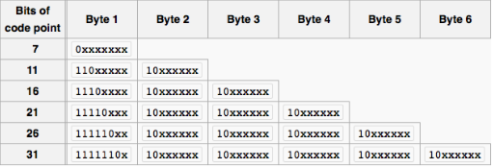
Here you see if you start with 0 then you have 7 bits to fill to make 1 byte. That is 2⁷ and gives you 128 characters (ASCII)
If you start with 110, it means you have 2 bytes and you need to have eleven bits to fill. 2¹¹ which is 2048 characters
1110 means 3 bytes (three 1's) and that gives you 16 bits to fill and that's 2¹⁶ which allows 65,536 characters.
All the way to 1111110, means 6 bytes and 31 bits to fill. 2³¹ is 2,147,483,648 characters

Slide 18
1.2 Text, sound and images
Understand how and why a computer represents an image, including the effects of the resolution and colour depth
An image is a series of pixels that are converted to binary, which is processed by a computer
The resolution is the number of pixels in the image
The colour depth is the number of bits used to represent each colour
The file size and quality of the image increases as the resolution and colour depth increase
Understand: How a bitmap is constructed
Able: Calculate the file size of an image
Answer: What is colour depth?

Slide 19
We will do more information that you need for your exam.
When you do AS level, you will be so thankful for this and the extra information is not hard.

Slide 20
Bitmap
What’s a map?
A drawing of locations, usually used to guide you.
What’s a bit
Binary 1 or Binary 0
What’s a bitmap?
A map of 1’s and 0’s
Used for images

Slide 21
Bitmap Images
Sometimes called Raster Images
Made up from pixels. (Kind of)
Pixel = Picture Element. A single illuminated dot.
Photo realistic
Photo realistic = Looks like real life

Slide 22
Flower
Here is a photo of a flower
It looks like a real flower
Zoomed in you can see its actually a lot of little squares.
But our stupid human eyes cannot see the little squares without zooming in. We just see a perfect flower.
This is how a bitmap image works.
Lots of little squares.

Slide 23
Questions
Questions:
Is a square a pixel?
How big is a square?
How do you know what to put in a square?
Is there a better way to represent it?

Slide 24
Is a square a pixel?
We said bitmap are made of pixels….
We saw, with the flower, that it’s a lot of little squares
So is a square a pixel? Pick the correct answer from the 5 choices below.
No, they are not the same.
Nope, not the same
A square and pixel are different
A pixel is a dot and a square is a square so they are different.
I cannot believe you made 5 ways to say a pixel and a square are different.

Slide 25
Why are they not the same.
Many books and websites say the squares and pixels are the same. Pixel is a dot, square is a square so what the difference.
A pixel has no fixed size, you can get big pixels, small pixels, medium pixels. But a square is 8 x 8 pixels.
So if you have small pixels it might look like:
But if you use larger pixels, then your square will look like:
Both are still 8x8
So 8x8 pixels = 1 square

Slide 26
How to draw a bitmap
Let’s say you want the letter A
Every white square is a 0 and every black square is a 1 (for now. In real life every white square is 1 and black is 0)

Slide 27
Bitmap in Binary
So if we look at the top row, its 00111000 Then its 01000100
Then the next row is 01000100 ……. And so on.
That’s it…. Kind of…. There are two more things we need to sort out.
1. How to count
2. How to colour
And also, really white should be 1 and black should be 0
0 | 0 | 1 | 1 | 1 | 0 | 0 | 0
0 | 1 | 0 | 0 | 0 | 1 | 0 | 0
0 | 1 | 0 | 0 | 0 | 1 | 0 | 0
0 | 1 | 0 | 0 | 0 | 1 | 0 | 0
0 | 1 | 1 | 1 | 1 | 1 | 0 | 0
0 | 1 | 0 | 0 | 0 | 1 | 0 | 0
0 | 1 | 0 | 0 | 0 | 1 | 0 | 0
0 | 0 | 0 | 0 | 0 | 0 | 0 | 0

Slide 28
Bitmap in Hex
0 | 0 | 1 | 1 | 1 | 0 | 0 | 0
0 | 1 | 0 | 0 | 0 | 1 | 0 | 0
0 | 1 | 0 | 0 | 0 | 1 | 0 | 0
0 | 1 | 0 | 0 | 0 | 1 | 0 | 0
0 | 1 | 1 | 1 | 1 | 1 | 0 | 0
0 | 1 | 0 | 0 | 0 | 1 | 0 | 0
0 | 1 | 0 | 0 | 0 | 1 | 0 | 0
0 | 0 | 0 | 0 | 0 | 0 | 0 | 0
We can count in hexadecimal.
One hex digit is 4 binary digits
So if we look at the first row:
Binary is 00111000 That’s 8 binary digits, so we can split it into 4 bits and 4 bits
0011 and 1000
So we can say the first row is 3 8 in hex
0 | 0 | 1 | 1 | 1 | 0 | 0 | 0
0 | 1 | 0 | 0 | 0 | 1 | 0 | 0
0 | 1 | 0 | 0 | 0 | 1 | 0 | 0
0 | 1 | 0 | 0 | 0 | 1 | 0 | 0
0 | 1 | 1 | 1 | 1 | 1 | 0 | 0
0 | 1 | 0 | 0 | 0 | 1 | 0 | 0
0 | 1 | 0 | 0 | 0 | 1 | 0 | 0
0 | 0 | 0 | 0 | 0 | 0 | 0 | 0
 | 2³ | 2² | 2¹ | 2⁰ | In Decimal | In Hex
Value | 8 | 4 | 2 | 1
Red Binary Half | 0 | 0 | 1 | 1 | 3 | 3
Blue Binary Half | 1 | 0 | 0 | 0 | 8 | 8

Slide 29
What’s this image in Binary and Hex?

Slide 30
What’s this image in Binary and Hex?
2³ | 2² | 2¹ | 2⁰ | Dec | Hex | 2³ | 2² | 2¹ | 2⁰ | Dec | Hex
8 | 4 | 2 | 1 |  |  | 8 | 4 | 2 | 1
0 | 1 | 1 | 1 | 7 | 7 | 1 | 1 | 1 | 0 | 14 | E
0 | 1 | 0 | 0 | 4 | 4 | 0 | 0 | 1 | 0 | 2 | 2
0 | 1 | 1 | 1 | 7 | 7 | 1 | 1 | 1 | 0 | 14 | E
1 | 1 | 0 | 0 | 12 | C | 0 | 0 | 1 | 1 | 3 | 3
1 | 0 | 0 | 0 | 8 | 8 | 0 | 0 | 1 | 1 | 3 | 3
1 | 1 | 1 | 1 | 15 | F | 1 | 1 | 1 | 1 | 15 | F
0 | 0 | 1 | 1 | 3 | 3 | 1 | 1 | 0 | 0 | 12 | C
0 | 0 | 1 | 1 | 3 | 3 | 1 | 1 | 0 | 0 | 12 | C
0 | 1 | 1 | 1 | 1 | 1 | 1 | 0
0 | 1 | 0 | 0 | 0 | 0 | 1 | 0
0 | 1 | 1 | 1 | 1 | 1 | 1 | 0
1 | 1 | 0 | 0 | 0 | 0 | 1 | 1
1 | 0 | 0 | 0 | 0 | 0 | 1 | 1
1 | 1 | 1 | 1 | 1 | 1 | 1 | 1
0 | 0 | 1 | 1 | 1 | 1 | 0 | 0
0 | 0 | 1 | 1 | 1 | 1 | 0 | 0

Slide 31
Too easy
So we can tell what the binary and hex values are for a bitmap image…But….
What numbers did we use for our Black ’A’?
0 and 1. Only used 2 numbers, only 2 colours, so its called a 1 bit image
WTF is it called a 1 bit image when it has 2 colours (black and white)
Because 2¹ = 2 (colours)

Slide 32
Colour Depth / Colour Bit
1 bit = 2¹ = 2 colours
2 bit = 2² = 4 colours
4 bit = 2⁴ = 16 colours
8 bit = 2⁸ = 256 colours
16 bit = 2¹⁶ = 65,536 colours
24 bit = 2²⁴ = 16,777,216 colours
32 bit = 2³² = 4,294,967,296 colours

Slide 33
24 bit 2²⁴ = 16, 777, 216 colours
8 bit 2⁸ = 256 colours

Slide 34
7 bit 2⁷ = 128 colours
6 bit 2⁶ = 64 colours

Slide 35
5 bit 2⁵ = 32 colours
4 bit 2⁴ = 16 colours

Slide 36
3 bit 2³ = 8 colours
2 bit 2² = 4 colours

Slide 37
24 bit 2²⁴ = 16,777,216 colours
1 bit 2¹ = 2 colours

Slide 38
So how do you do colour?
Well we know black and white, 2 colours, 1 bit image, its either 0 or 1.
Let’s say you want a 3 bit image. It can have up to 8 colours
Now its important to remember that white is 1 and black is 0
0 | 0 | 1 | 1 | 1 | 0 | 0 | 0
0 | 1 | 0 | 0 | 0 | 1 | 0 | 0
0 | 1 | 0 | 0 | 0 | 1 | 0 | 0
0 | 1 | 0 | 0 | 0 | 1 | 0 | 0
0 | 1 | 1 | 1 | 1 | 1 | 0 | 0
0 | 1 | 0 | 0 | 0 | 1 | 0 | 0
0 | 1 | 0 | 0 | 0 | 1 | 0 | 0
0 | 0 | 0 | 0 | 0 | 0 | 0 | 0

Slide 39
Colour
0 | 1
1 bit 2¹ = 2 colours
00 | 01 | 10 | 11
2 bit 2² = 4 colours
3 bit 2³ = 8 colours
000 | 001 | 010 | 011 | 100 | 101 | 110 | 111

Slide 40
So, with 3 bit, what is our binary and hex for this letter E
000 | 001 | 010 | 011 | 100 | 101 | 110 | 111

Slide 41
111 | 111 | 111 | 111 | 111 | 111 | 111 | 111
111 | 101 | 011 | 011 | 011 | 011 | 111 | 111
111 | 101 | 111 | 111 | 111 | 111 | 111 | 111
111 | 101 | 110 | 110 | 000 | 111 | 111 | 111
111 | 101 | 010 | 010 | 000 | 111 | 111 | 111
111 | 101 | 111 | 111 | 111 | 111 | 111 | 111
111 | 101 | 100 | 100 | 100 | 100 | 111 | 111
111 | 111 | 111 | 111 | 111 | 111 | 111 | 111

Slide 42
Channels
But how do you know that 010 is green and 101 is pink?
We said that this the chart for 2 bit (4 colour image)
But we saw this as our 2 bit image:
Where is that yellow coming from?
00 | 01 | 10 | 11
00 | 01 | 10 | 11

Slide 43
More bits means LESS colour??
Look at 2 bit:
Even if we swap in for that yellow
Now look at 3 bit:
00 | 01 | 10 | 11
00 | 01 | 10 | 11
000 | 001 | 010 | 011 | 100 | 101 | 110 | 111

Slide 44
More bits means LESS colour??
3 bit is better, right? It has more colours.
But what happens in 3 bit if I want this colour?
I have it in 2 bit (01) but not in 3 bit.
000 | 001 | 010 | 011 | 100 | 101 | 110 | 111
00 | 01 | 10 | 11

Slide 45
Channels
We split the colours up.
Every colour can be made with a mixture of Red, Green and Blue. RGB.
So for one bitmap image we split it into 3 channels.
A red channel
A green channel
A blue channel
Channel = Another word for layer

Slide 46
This grey
So this grey is actually not grey
Its 89 Red, 89 Green and 89 Blue (that was just a super coincidence)
But that 89 Red, 89 Green and 89 Blue, is that Decimal 89 or Hex 89…. Its decimal 89….. Why decimal 89, just because it was common to use for 8-bit images.
 | 2⁷ | 2⁶ | 2⁵ | 2⁴ | 2³ | 2² | 2¹ | 2⁰ | What colour is it | When it mixed
 | 128 | 64 | 32 | 16 | 8 | 4 | 2 | 1
Red | 0 | 1 | 0 | 1 | 1 | 0 | 0 | 1
Green | 0 | 1 | 0 | 1 | 1 | 0 | 0 | 1
Blue | 0 | 1 | 0 | 1 | 1 | 0 | 0 | 1

Slide 47
So how does it work
Most images are split into a red channel, green channel and blue channel.
Then these channels are merged and the mix of colors is what you see as your final image

Slide 48
Real Numbers
This grey box was 89 Red, 89 Green and 89 Blue
Its an 8 bit image. It has 3 channels. Red, Green and Blue, so when its merged it blends into grey.
For each pixel, which is an 8x8 square, each square is 8 binary bits long
For a more complicated image, each square is still 8 bits, but the values change based on how much red, green and blue is needed.
01011001 | 01011001 | 01011001 | 01011001 | 01011001 | 01011001 | 01011001 | 01011001
01011001 | 01011001 | 01011001 | 01011001 | 01011001 | 01011001 | 01011001 | 01011001
01011001 | 01011001 | 01011001 | 01011001 | 01011001 | 01011001 | 01011001 | 01011001
01011001 | 01011001 | 01011001 | 01011001 | 01011001 | 01011001 | 01011001 | 01011001
01011001 | 01011001 | 01011001 | 01011001 | 01011001 | 01011001 | 01011001 | 01011001
01011001 | 01011001 | 01011001 | 01011001 | 01011001 | 01011001 | 01011001 | 01011001
01011001 | 01011001 | 01011001 | 01011001 | 01011001 | 01011001 | 01011001 | 01011001
01011001 | 01011001 | 01011001 | 01011001 | 01011001 | 01011001 | 01011001 | 01011001
01011001 | 01011001 | 01011001 | 01011001 | 01011001 | 01011001 | 01011001 | 01011001
01011001 | 01011001 | 01011001 | 01011001 | 01011001 | 01011001 | 01011001 | 01011001
01011001 | 01011001 | 01011001 | 01011001 | 01011001 | 01011001 | 01011001 | 01011001
01011001 | 01011001 | 01011001 | 01011001 | 01011001 | 01011001 | 01011001 | 01011001
01011001 | 01011001 | 01011001 | 01011001 | 01011001 | 01011001 | 01011001 | 01011001
01011001 | 01011001 | 01011001 | 01011001 | 01011001 | 01011001 | 01011001 | 01011001
01011001 | 01011001 | 01011001 | 01011001 | 01011001 | 01011001 | 01011001 | 01011001
01011001 | 01011001 | 01011001 | 01011001 | 01011001 | 01011001 | 01011001 | 01011001
01011001 | 01011001 | 01011001 | 01011001 | 01011001 | 01011001 | 01011001 | 01011001
01011001 | 01011001 | 01011001 | 01011001 | 01011001 | 01011001 | 01011001 | 01011001
01011001 | 01011001 | 01011001 | 01011001 | 01011001 | 01011001 | 01011001 | 01011001
01011001 | 01011001 | 01011001 | 01011001 | 01011001 | 01011001 | 01011001 | 01011001
01011001 | 01011001 | 01011001 | 01011001 | 01011001 | 01011001 | 01011001 | 01011001
01011001 | 01011001 | 01011001 | 01011001 | 01011001 | 01011001 | 01011001 | 01011001
01011001 | 01011001 | 01011001 | 01011001 | 01011001 | 01011001 | 01011001 | 01011001
01011001 | 01011001 | 01011001 | 01011001 | 01011001 | 01011001 | 01011001 | 01011001

Slide 50
What else?
So a bitmap image is made up of pixels… is that all?
Nope.
You need to store data about the image.
You need to add the size of the image, what colour system you are using and many other things

Slide 55
Resolution
Image resolution = horizontal pixels x vertical pixels of your IMAGE
Screen resolution = horizontal pixels x vertical pixels of your SCREEN DISPLAY
If my image is 4000 x 4000 and my screen is 1080 x 720 and I view the image full screen, would it look good or bad?
What if my image is 600 x 480 and my screen is 1080 x 720 and I view the image full screen, would it look good or bad?

Slide 56
Images
To work out the file size of a image, you need to know 3 things
Horizontal pixels
Vertical pixels
Bit depth
Your formula is
Vertical x Horizontal x bit depth

Slide 57
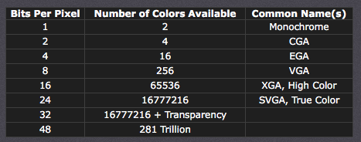
Bit Depth
How many colours are in a image

Slide 58
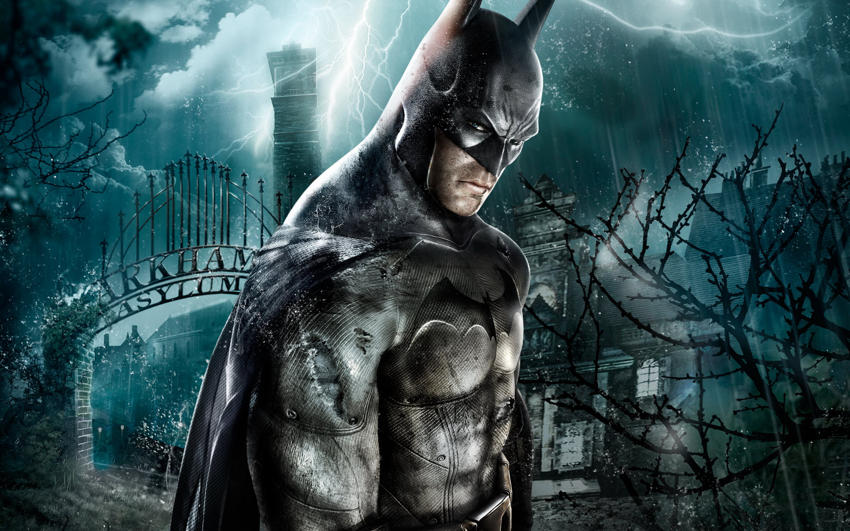
Examples
Here is a black and white image
Only has 1 bit
Which means 2 colours
2¹ = 2
So 600 x 800 x 1
480,000 bits (divide this by 8 to get..)
60,000 bytes (divide this by 1024..)
58.5 KB (divide this by 1024..)
0.05 MB
600
800

Slide 59
Examples
Here is a 16bit image
Has 65,536 colours
2¹⁶ = 65,536
So 600 x 800 x 16
7,680,000 bits (divide this by 8..)
960,000 bytes (divide by 1024)
937.5 KB (divide by 1024..)
0.9MB
600
800

Slide 60
Quick Bits
Bitmap = Uses pixels to make an image
More pixels = better resolution
When you zoom in the number of pixels stays the same – so when you zoom it loses quality
Photo realistic

Slide 61
Vector
Vector images are a different type of image
It does NOT use pixels.
It just uses maths.
Its made up of
Drawing Object
Drawing List
Property
User Space

Slide 62
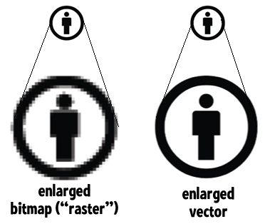
Compare to Bitmap
Because with vector you only care about drawing lines from point A to point B, when you resize the image point A and point B get adjusted accordingly

Slide 63
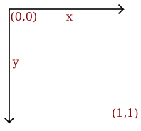
What makes a vector image?
First you need a co-ordinate system. This is called USER SPACE.

Slide 64

What makes a vector image?
draw circle
center 0.5, 0.5
radius 0.4
fill-color yellow
stroke-color black
stroke-width 0.05
draw circle
center 0.35, 0.4
radius 0.05
fill-color black
draw circle
center 0.65, 0.4
radius 0.05
fill-color black
draw line
start 0.3, 0.6
end 0.7, 0.6
stroke-color black
stroke-width 0.1

Slide 65
What makes a vector image?
Drawing Object
What you are actually drawing. Circle, Square, Text, Lines etc..
Property
The location, size, stroke and colour of the drawing object
Drawling list
What to draw in what order (what layers are first)
User Space
The area you are drawing in

Slide 66
Vector
Usually less file size
Scalable, resize and you keep the quality
Not photo realistic

Slide 67
Bitmap or Vector?
Would you pick bitmap or vector for the following?
A large poster of a human face
A business logo
Text
A cartoon character
Your ID card photo
Task
Make one image as a bitmap and the SAME image as a vector.
What are 3 similarities between using bitmap and vector software?
What are 3 differences between using bitmap and vector software?

Slide 68
Today
Understand how and why a computer represents • sound, including the effects of the sample rate and sample resolution
A sound wave is sampled for sound to be converted to binary, which is processed by a computer
The sample rate is the number of samples taken in a second
The sample resolution is the number of bits per sample
The accuracy of the recording and the file size increases as the sample rate and resolution increase
Understand: How to represent sound
Able: Calculate the file size for a sound
Answer: What is sample rate?

Slide 69
How is sound represented?
Sampling
Sampling rate
Sampling resolution
Using sound software

Slide 70
What is sound?
Which one is correct?
Sound is air particles moving
Sound are vibrations being picked up by your ear
Sound is measured by waves
All are true

Slide 71
What is sound?
If something can make a vibration, then it moves air particles around it.
These air particles then move other air particles which move other air particles
This continues until it reaches your ear
When it enters your ear then it becomes sound.
Before this – its just compression waves.

Slide 72
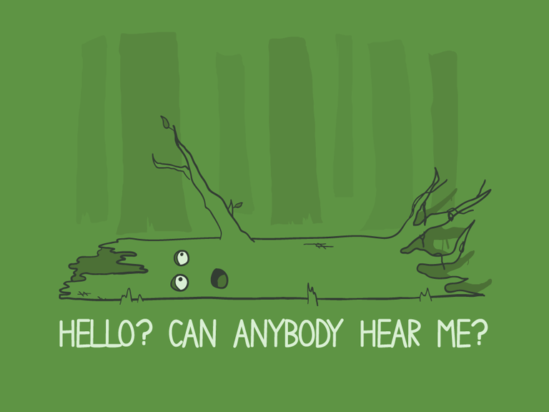
Famous Question
If a tree falls over and there is no one to hear it, does it make a sound?

Slide 73
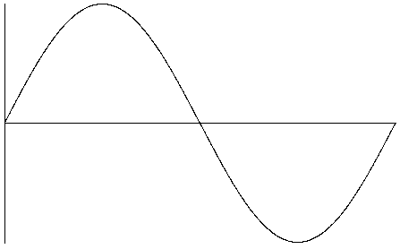
Sine wave
Sound is represented by a wave, or sine wave. It does NOT exist like this in real life, its just used to help describe sound

Slide 74
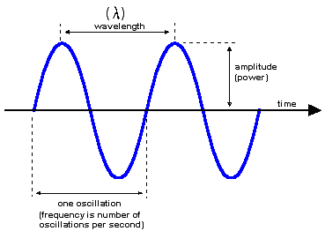
Sine wave
Amplitude – Maximum disturbance from undisturbed position
Frequency – How many times a complete wave form in 1 second
Wavelength – Distance between one crest and the next

Slide 75
Match up the statements
Sampling
Sampling rate
Sampling resolution
Number of samples taken per second
Converting a sound wave in a digital form. This take regular measurements of the sound
How many samples can be taken. 8-bit rate = 2⁸ = 256 samples
16 bit = 2¹⁶ = 65,536 samples

Slide 76
Match up the statements
Sampling
Sampling rate
Sampling resolution
Converting a sound wave in a digital form. This take regular measurements of the sound
Number of samples taken per second
How many samples can be taken. 8-bit rate = 2⁸ = 256 samples
16 bit = 2¹⁶ = 65,536 samples

Slide 77
File Size
File size (bits) =
sampling frequency (Hz) x sampling depth (bits) x length of sound (s) x channels
Example
A stereo song has to be recorded at CD quality. The song is 4 minutes and 8 seconds long. How much disk space would the captured song occupy?
Settings for CD quality are:
Sampling frequency = 44100 Hz (44.1KHz)
Sampling depth = 16 bit
Length of song = 4 x 60 + 8 = 248 seconds
File size (bits) = 44100 x 16 x 248 x 2 = 349977600
File size (bytes) = 349977600 / 8 = 43747200
File size (kilobytes) = 43747200 / 1024 = 42721.88
File size (megabytes) = 42721.88 / 1024 = 41.72Mb

Slide 78
Questions
1. A stereo song has to be recorded at CD quality. The song is 2 minutes and 32 seconds long. What file size would the song have?
2. A stereo song has to be recorded at CD quality. The song is 4 minutes and 45 seconds long. What file size would the song have?
3. A 1 minute 15 second audio track is sampled in mono at 22.5KHz using an 8 bit sample rate. What file size would the track be?
4. A 32 second audio track is sampled in stereo at 22.5KHz using a 16 bit sample rate. What file size would the track be?

Slide 79
Task
Record / Get an audio file and export it with different sample rates and resolution to hear the difference

Slide 80
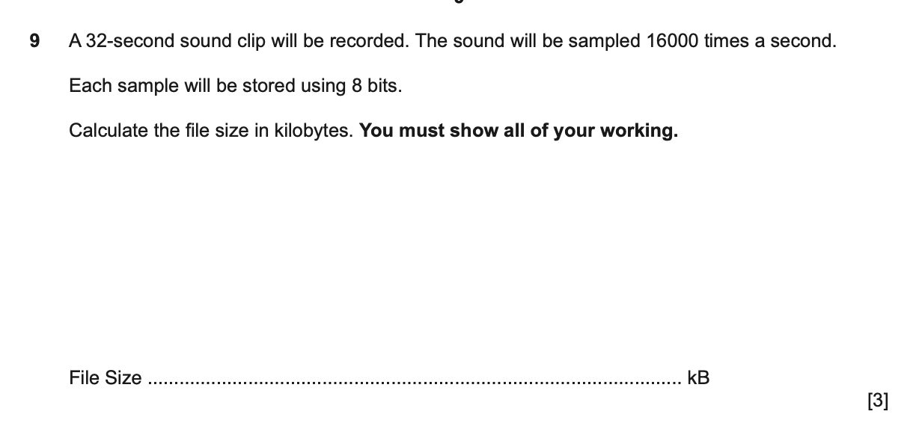
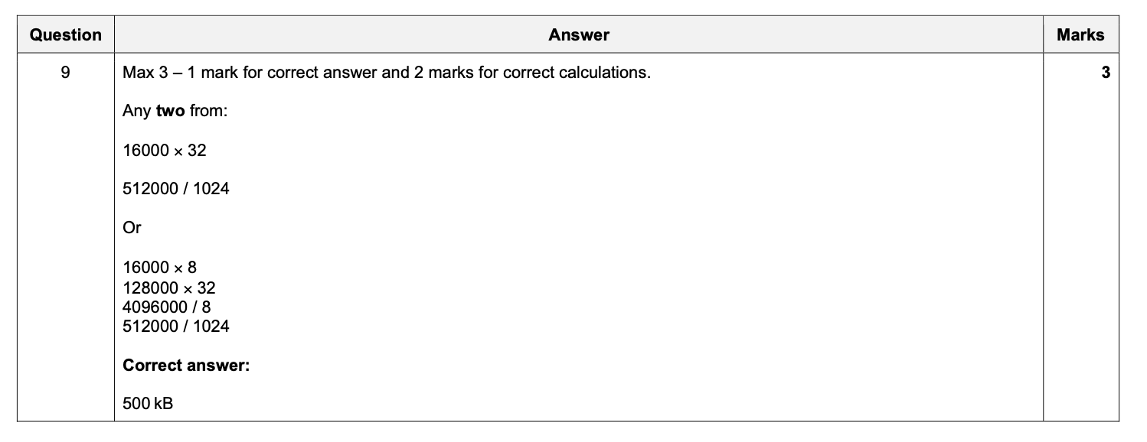

Slide 81
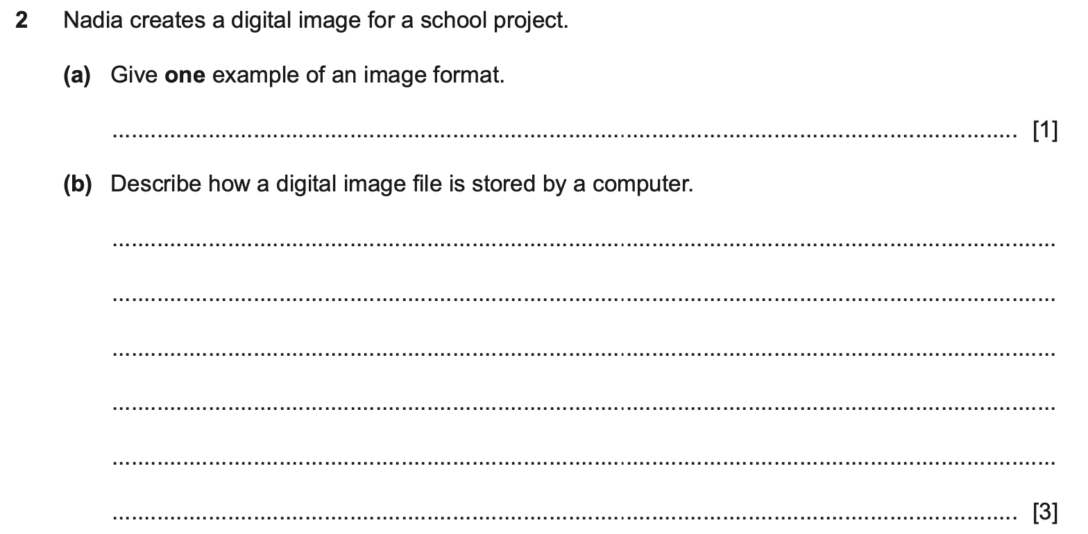
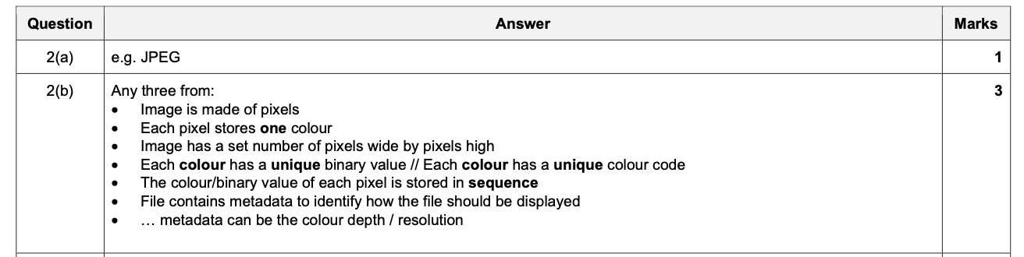

Slide 82
